Slide 1


God B.L.E.S.S. FxA
Sai Prashanth Chandramouli
Firefox Accounts
irc: saipc
GitHub: TDA
email: thatsenough@youstalker.com

Slide 2
Disclaimer
All details on these slides are purely fictitious based on fact.
No Animals were harmed in the making of this slideshow (unless you count me).
I make obscure references to filmography and some computer fields. Ask if it is unclear.
Any references, messages, images bearing resemblance to any real life object, person or animal were probably NOT coincidental, and any that are found to be offensive were probably meant to be offensive.
So quit whining and let’s move on to the next slide.
P.S: Most of this was copied over from last year, actually, all of it.

Slide 3
Why the uninspired title?
Frankly speaking, cause I couldn’t come up with anything better.
But more importantly, cause my work this summer can be categorized into 5 things:
B – Bugs (Quite a few of them, you will see)
L – Linting (Again???)
E – E-Mails (funny cause I have been working with emails for 1.5 years now)
S – Styles (CSS & Sass <3)
S – Security (Finally, something important eh?)

Slide 4
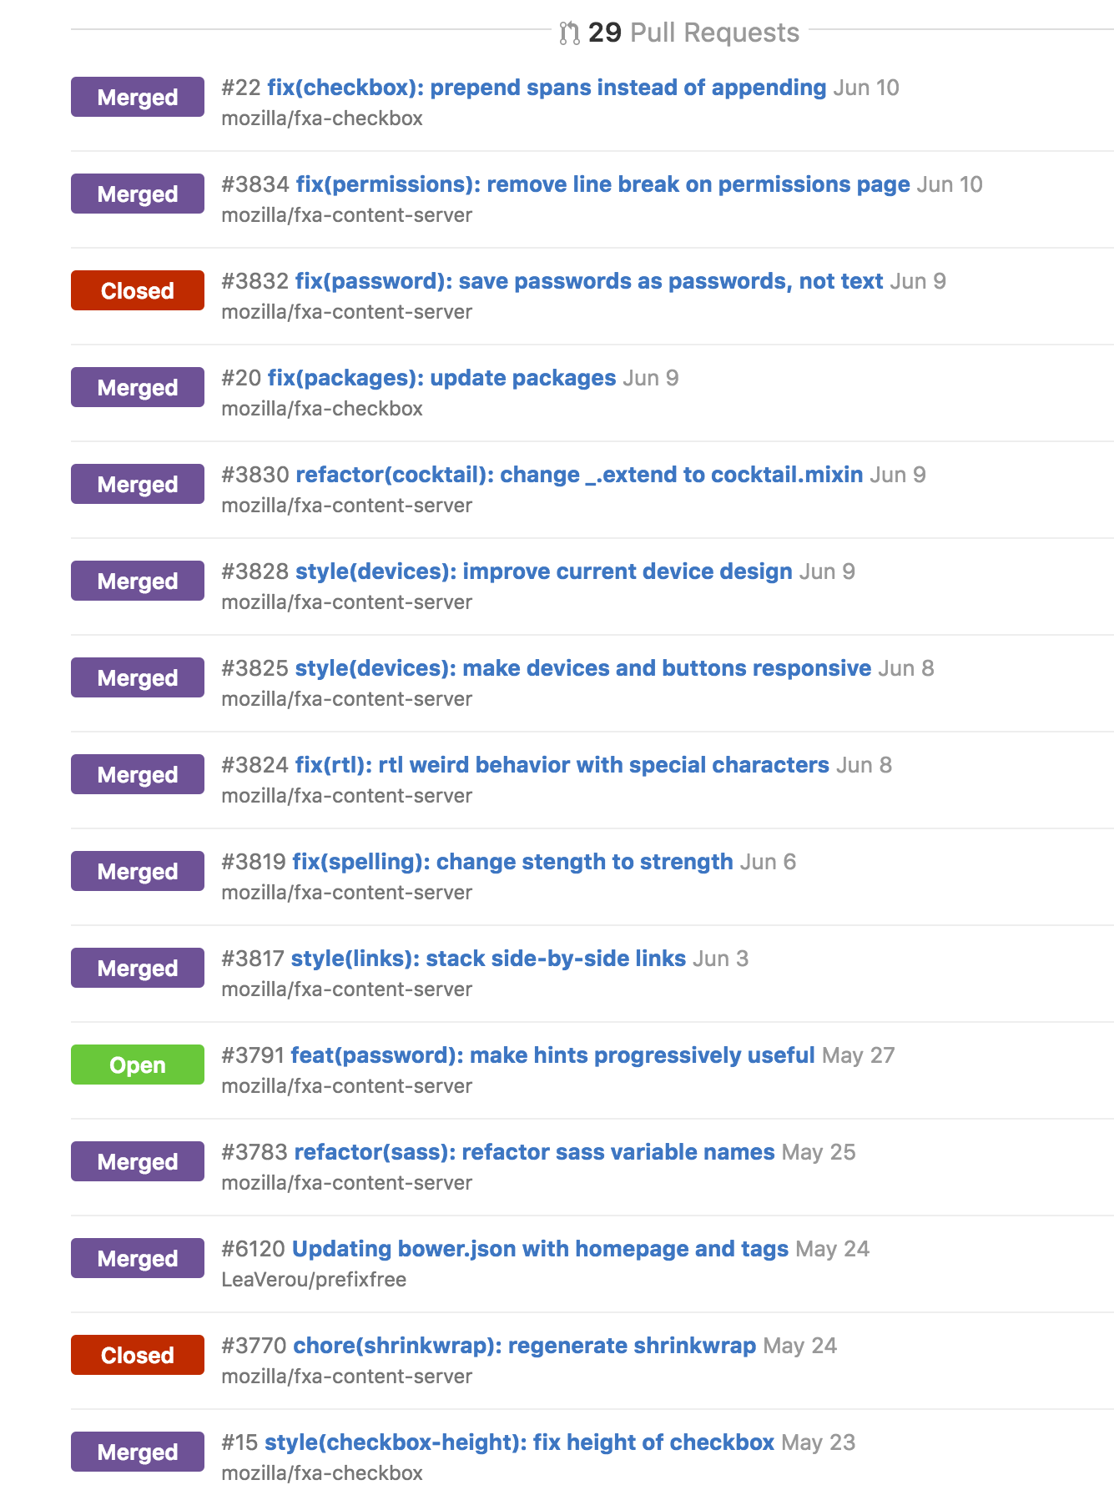
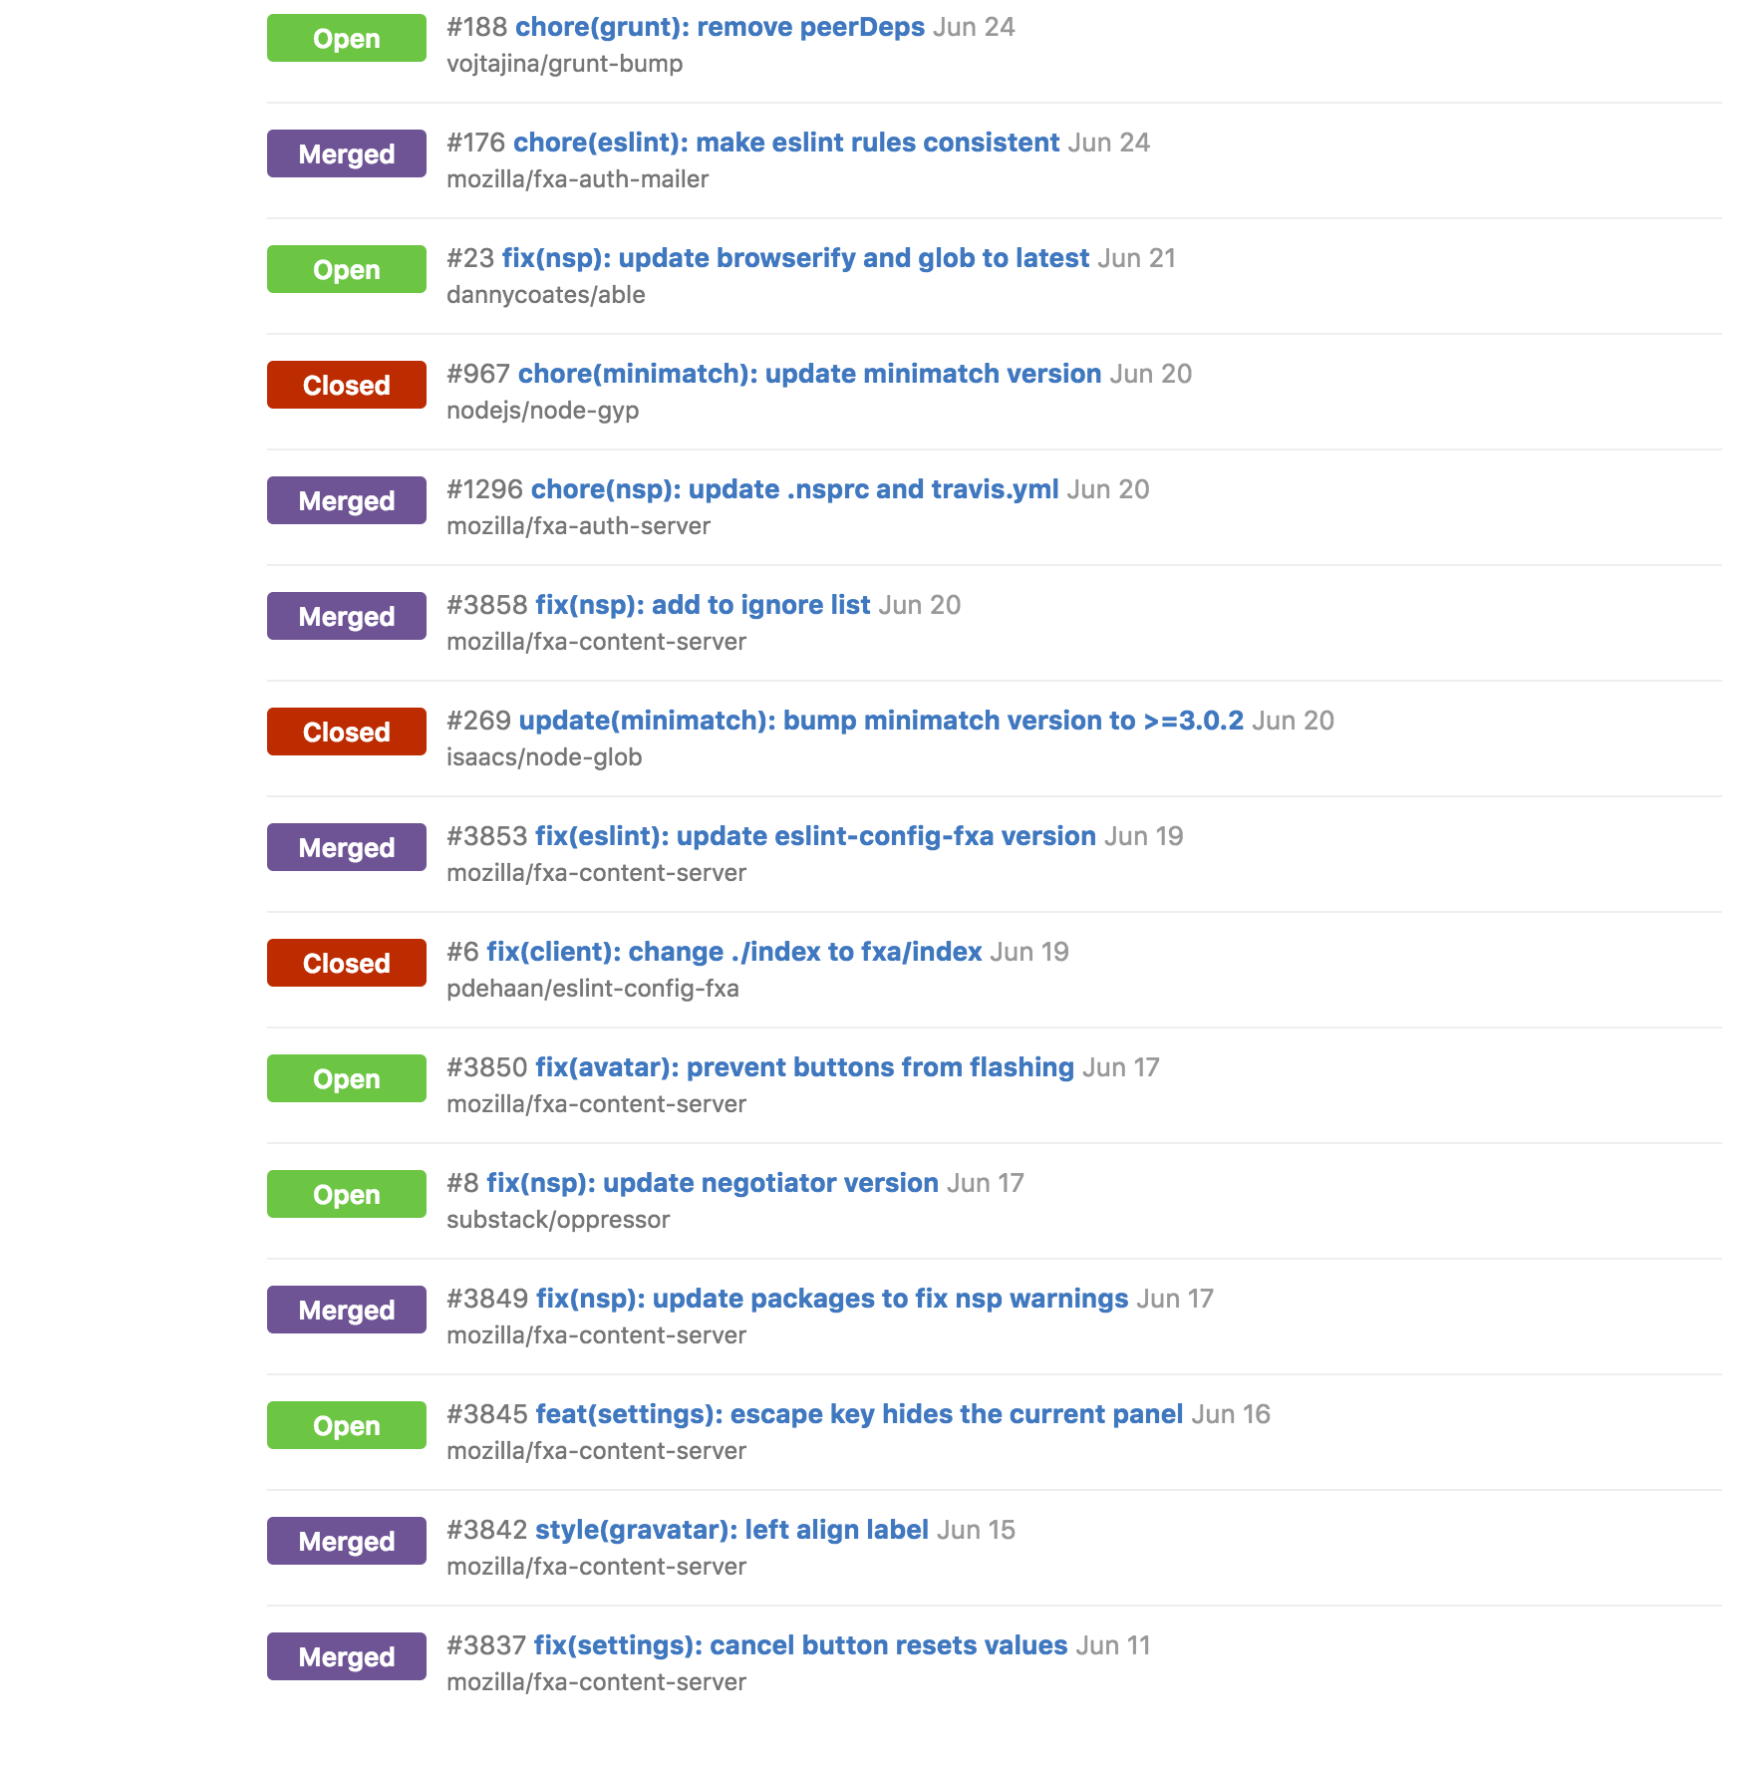
So how did my Summer go?
I worked on a bunch of bug fixes, 47 to be exact.

Slide 5
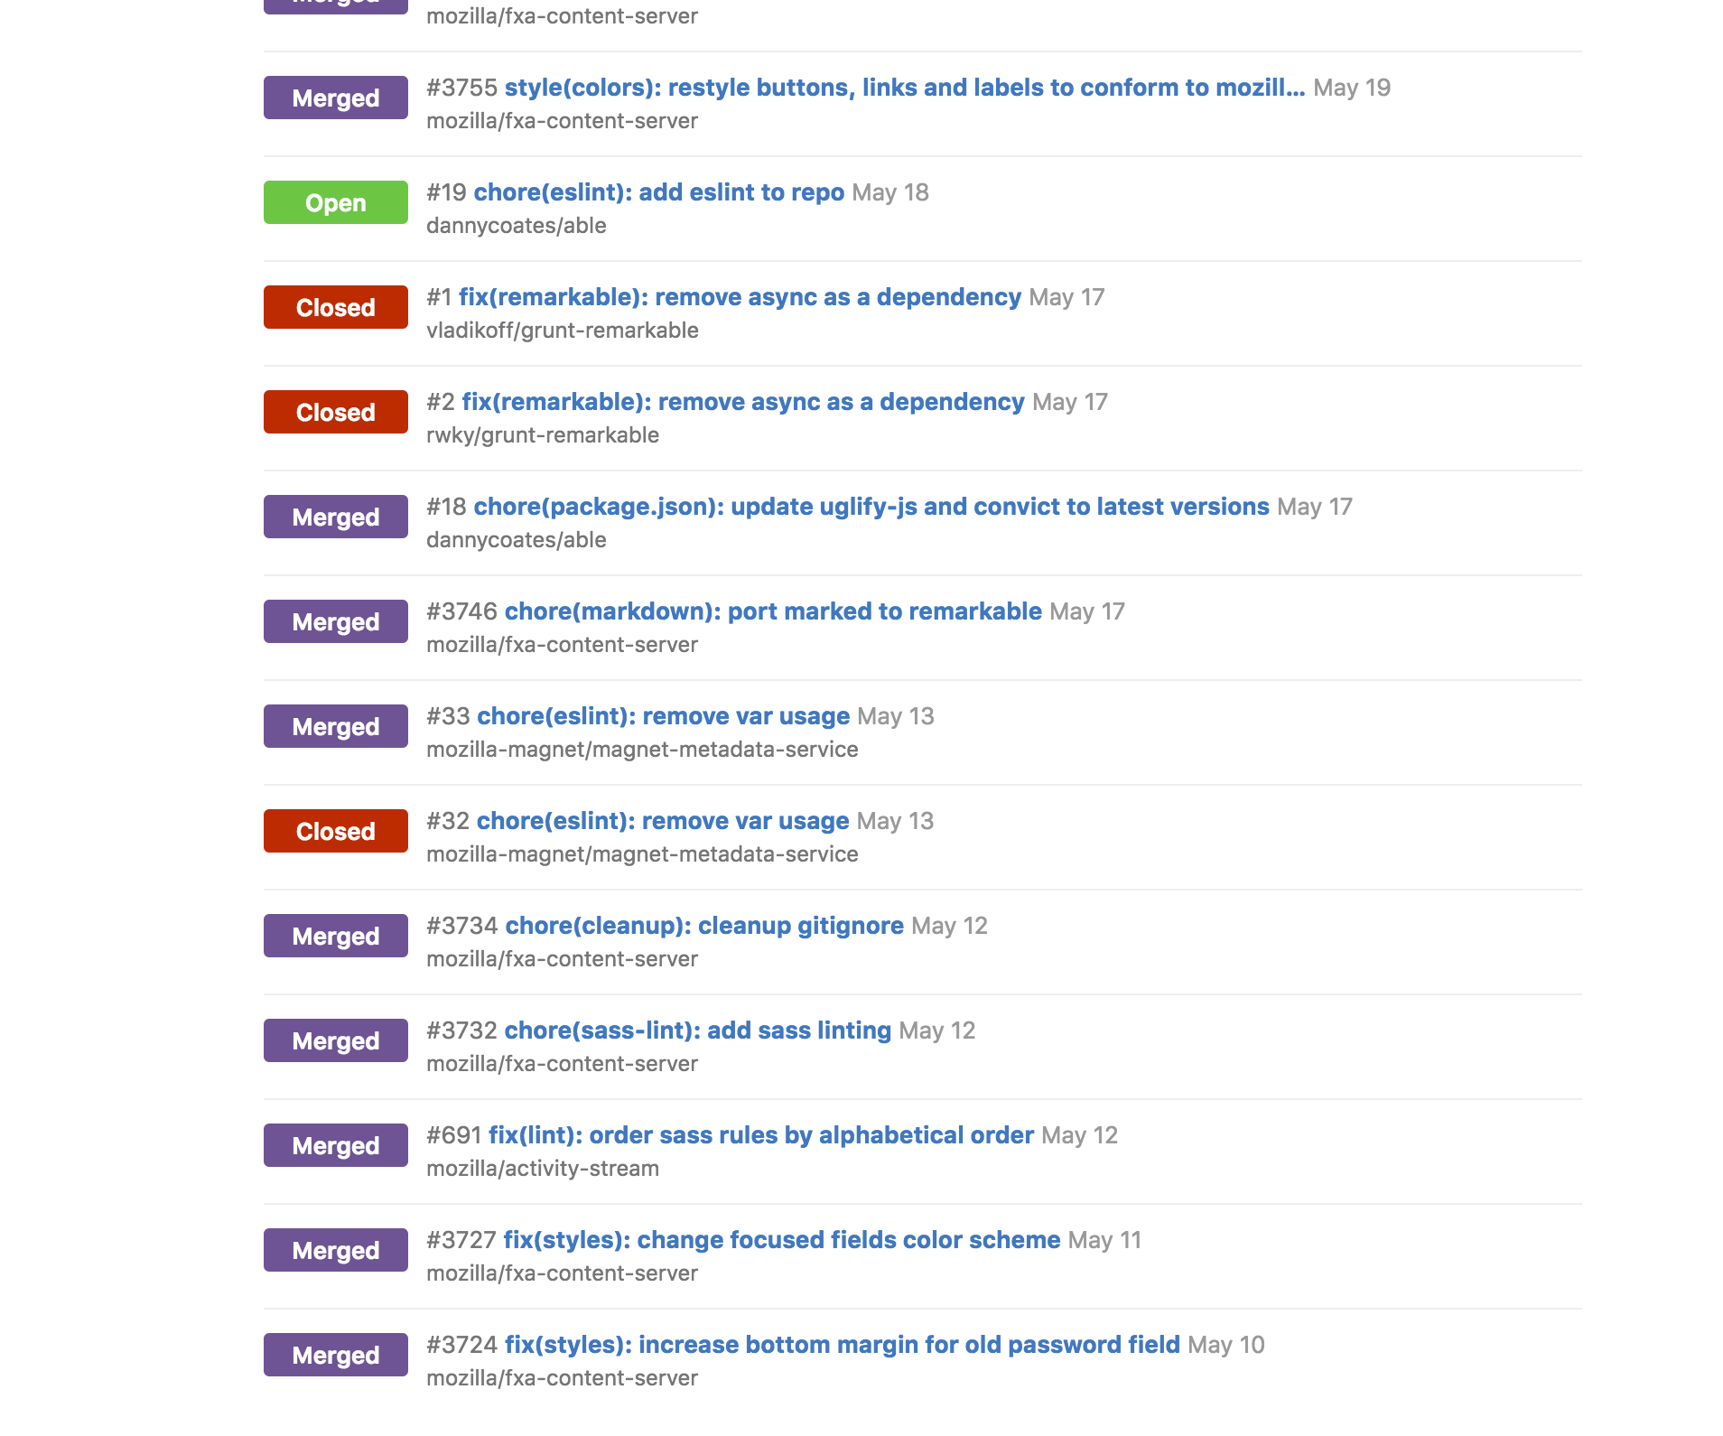

Just bugs?
Why you hating on bugs? Bugs’ important, listen to the guy on the right.

Slide 6
Well.. And?
Plenty of small bugs like:
ESLint fixes
Sasslint fixes
Node Security Advisories – Updating dependencies
Sometimes going 4-5 repos downstream
Style fixes, like
Widths, heights and the like
Stacking links
Making devices view responsive
Using ultra cool CSS stuff like `fit-content` and `calc`
Weird RTL issues
Aligning fxa-checkbox
Preventing buttons from flashing on page load (not FOUT)
Adjusting clickable areas in forms and links

Slide 7
Any features…?
Ok, and some small handy features:
Added sass-linting to our repos
Making FxA settings panels more keyboard accessible
Unified the styles used in FxA with those in Mozilla’s Style Guide for buttons, colors, links and text
I also refactored our files, ensuring that:
We used better variable names in our sass files
We used better variable values in our sass files
We ported our mixins to Cocktail from Underscore, completely

Slide 8
Did you actually do anything useful? Like a project?
Surprisingly, I actually did work on 3 really nice projects this Summer:
Password hints – Making better passwords a reality
Geolocation data in e-mail communication
Geoprofiling based on user history

Slide 9
Password Hints
Problem:
People choose crappy passwords
Stuff like “Password”, “abc123”, “dragondragon”
Attackers might bruteforce into an account by trying out common passwords
But isn’t bruteforcing rate-limited? How can attackers try ALL possible common passwords?

Slide 10
Password Hints – Continued..
Real problem:
People use the same crappy passwords across different websites
Leads to something called ”Password Reuse Attack”
Famous examples:
HBGary hack
Houston Astros
GitHub
Carbonite

Slide 11
Password Hints – Continued..
So what do we do?
You can make Software as secure as possible, doesn’t matter
Salting
Stronger Encryption
Weakest link in the chain
Humans
Treat the disease, not the symptoms
Notes:
Disease is user ignorance

Slide 12
Password Hints – Continued..
So what did we do?
Bloomfilter based Password Strength Checker
Last summer, we detected weak passwords
This summer, we protected the users
Interactive password prompts to help users create a stronger password

Slide 13
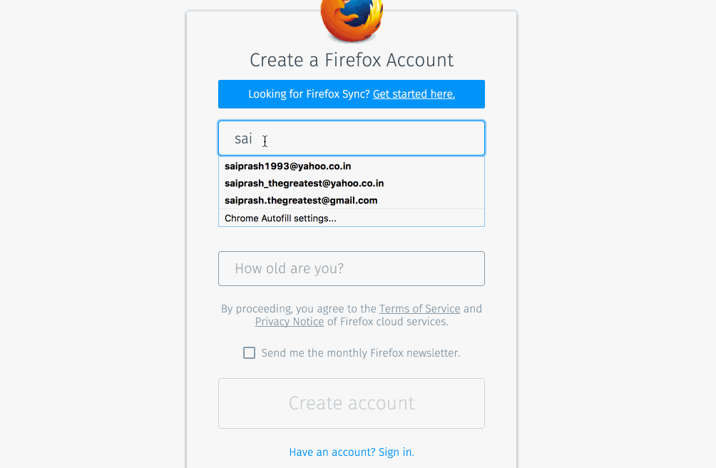

Slide 14
Security vs Usability
So why not block the weak passwords altogether¹?
Usability is affected when you enforce strict rules on the users
Ultimately, users should be allowed to decide what they want
https://support.mozilla.org/en-US/kb/create-secure-passwords-keep-your-identity-safe
[1] http://gizmodo.com/microsoft-is-banning-your-dumb-passwords-1778848643
Notes:
goal: educate users, not enforce rules on them

Slide 15
Geolocation Data in e-mails
Problem:
Users get a lot of e-mails from different websites telling them about new log-ins
Users need enough data to know if they were the ones that really logged in, or an attacker was trying to log in to their account

Slide 16
Geolocation e-mails – Continued..
What do we do:
At the very minimum, we need:
IP Address used to login
Device that was used to login
City, Country of login
Time of login

Slide 17
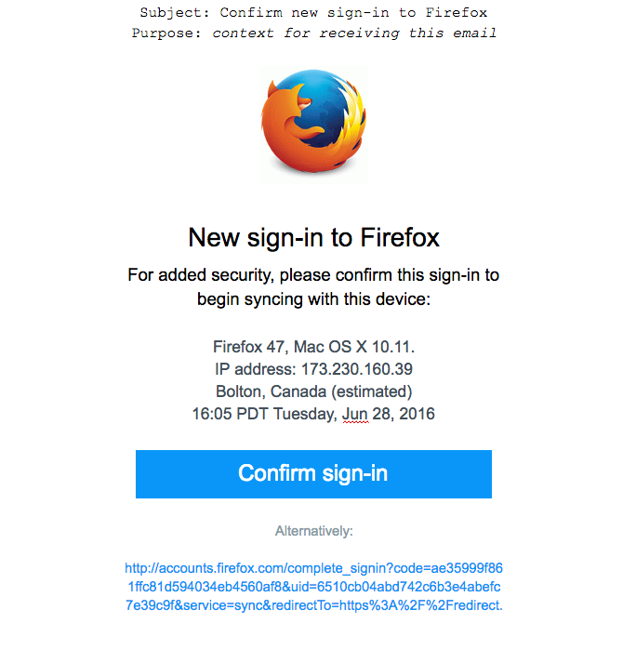

Slide 18
Solution: Mozilla fxa-geodb
We created a new node module, which can perform reverse IP lookup
Makes use of the maxmind IP databases
Allows configurable automatic updates of the IP databases that we use
99.8% accurate on a country level
72% accurate on a city-level with a 62 mile (100km) radius.
Can be found at Mozilla/fxa-geodb on GitHub
Notes:
power to customize
easy to use

Slide 19
Solution: Mozilla fxa-geodb
Data returned:
City
Country
Accuracy radius
Latitude
Longitude
Timezone

Slide 20
Geoprofiling
Problem
Imagine getting an e-mail every time you sign in
Now imagine your grandma getting an e-mail every time she signs in
If one of those two didn’t sound like any trouble at all, feel free to skip this section
Real problem
We need a way to “automatically” determine if a login attempt is legit or not
We should not burden users with too much data about login
Usability vs Security, again.
Notes:
private browsing
Computers are dumb, we need to tell them how to differentiate legit logins and malicious logins

Slide 21
Geoprofiling – Continued..
What is profiling? :O
Detecting and evaluating patterns of human behavior to find what exactly they are capable of.
Ok, what is geoprofiling?
Conventionally, used in criminal investigations to figure out where the point of origin (residence) of a criminal is.
We lost you, how does this tie in with e-mails??
Notes:
instead of using geoprofiling to find what's in common,
we can use it to find what's uncommon

Slide 22
Geoprofiling – Continued..
Using geoprofiling for anomaly detection
Figure out a `profile` for each user
Detect anomalies in a user profile
Analogies:
Coffee
LSAT’s
Traditional Intruder detection systems (IDS)

Slide 23
Geoprofiling – Continued..
What do we do?
Typical ideas involve profiling the user based on information that we already have
Maintain a history of stuff like
IP Addresses
Location
Devices of say, the last 5 logins of the user.

Slide 24
Geoprofiling – Continued..
Typical User history:
122.212.221.122 | <uid> | San Francisco, USA | Firefox 48.0 | 4.38 PM PDT, June 21, 2016
122.212.221.64 | <uid> | San Francisco, USA | Firefox 49.0 | 6.13 PM PDT, June 21, 2016
122.221.21.156 | <uid> | Mountain View, USA | Firefox 47.0 | 7.54 PM PDT, June 22, 2016
206.234.9.11 | <uid> | San Francisco, USA | Internet Explorer | 12.38 AM PDT, June 23, 2016
111.99.66.111 | <uid> | Beijing, China | Firefox 49.0 | 11.44 PM CST, June 24, 2016

Slide 25
Geoprofiling – Continued..
Profiled User history:
122.212.221.122 | <uid> | San Francisco, USA | Firefox 48.0 | 4.38 PM PDT, June 21, 2016
122.212.221.64 | <uid> | San Francisco, USA | Firefox 49.0 | 6.13 PM PDT, June 21, 2016
122.221.21.156 | <uid> | Mountain View, USA | Firefox 47.0 | 7.54 PM PDT, June 22, 2016
206.234.9.11 | <uid> | San Francisco, USA | Internet Explorer | 12.38 AM PDT, June 23, 2016
111.99.66.111 | <uid> | Beijing, China | Firefox 49.0 | 11.44 PM CST, June 24, 2016

Slide 26
Geoprofiling – Continued..
How to profile?
Anomalies in devices are straightforward to detect
Anomalies in location are slightly more complicated:
Location data is not 100% accurate
We need to check for a radius instead of a point
If user logged in from SFO, and then MV, which is his actual point of residence??

Slide 27
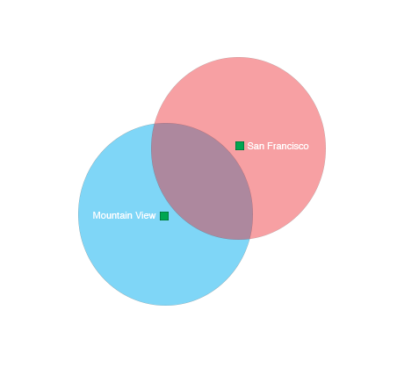
Geoprofiling – Continued..

Slide 28
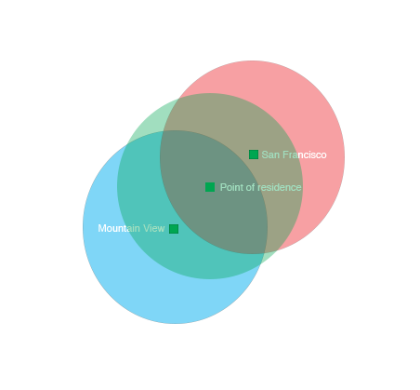
Geoprofiling – Continued..

Slide 29
Geoprofiling – Continued..
So what are we planning to do?
Design the infrastructure to collect data about user logins
What data are we collecting?
How does it affect privacy?
What is the expected behavior?
Success rate metrics?
Develop and use this infrastructure to maintain history of user logins
Gather metrics about how well our infrastructure performs:
Sufficient Data to maintain history
Accuracy
Success rate

Slide 30
Geoprofiling – Continued..
Caveats
Geoprofiling needs a few good solid locations to kick off a profile
Too much variance screws things up
People on TOR, or other IP Masking/Spoofing mechanisms
Does that mean its not good enough?
It simply means, worst case scenario, we get the same amount of e-mails we get today
But best case, we make the lives of users so much better, and prevent malicious attackers

Slide 31
Geoprofiling – Continued..
Extensions
Future work can also incorporate more powerful geoprofiling by flagging attackers’ point of origin, allowing us to figure out where the attacks are coming from
Display a ‘history of logins’ security panel for users, that can show them their logins, and allow them to flag anything that seems amiss
Add machine-learning mumbo-jumbo to prevent login attempts from IP’s that appear to be anomalous

Slide 32
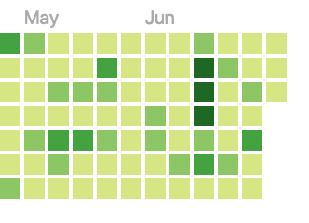
So how was my Summer you ask?
In one word: Awesome.
In three words: Productive and Awesome.

Slide 33
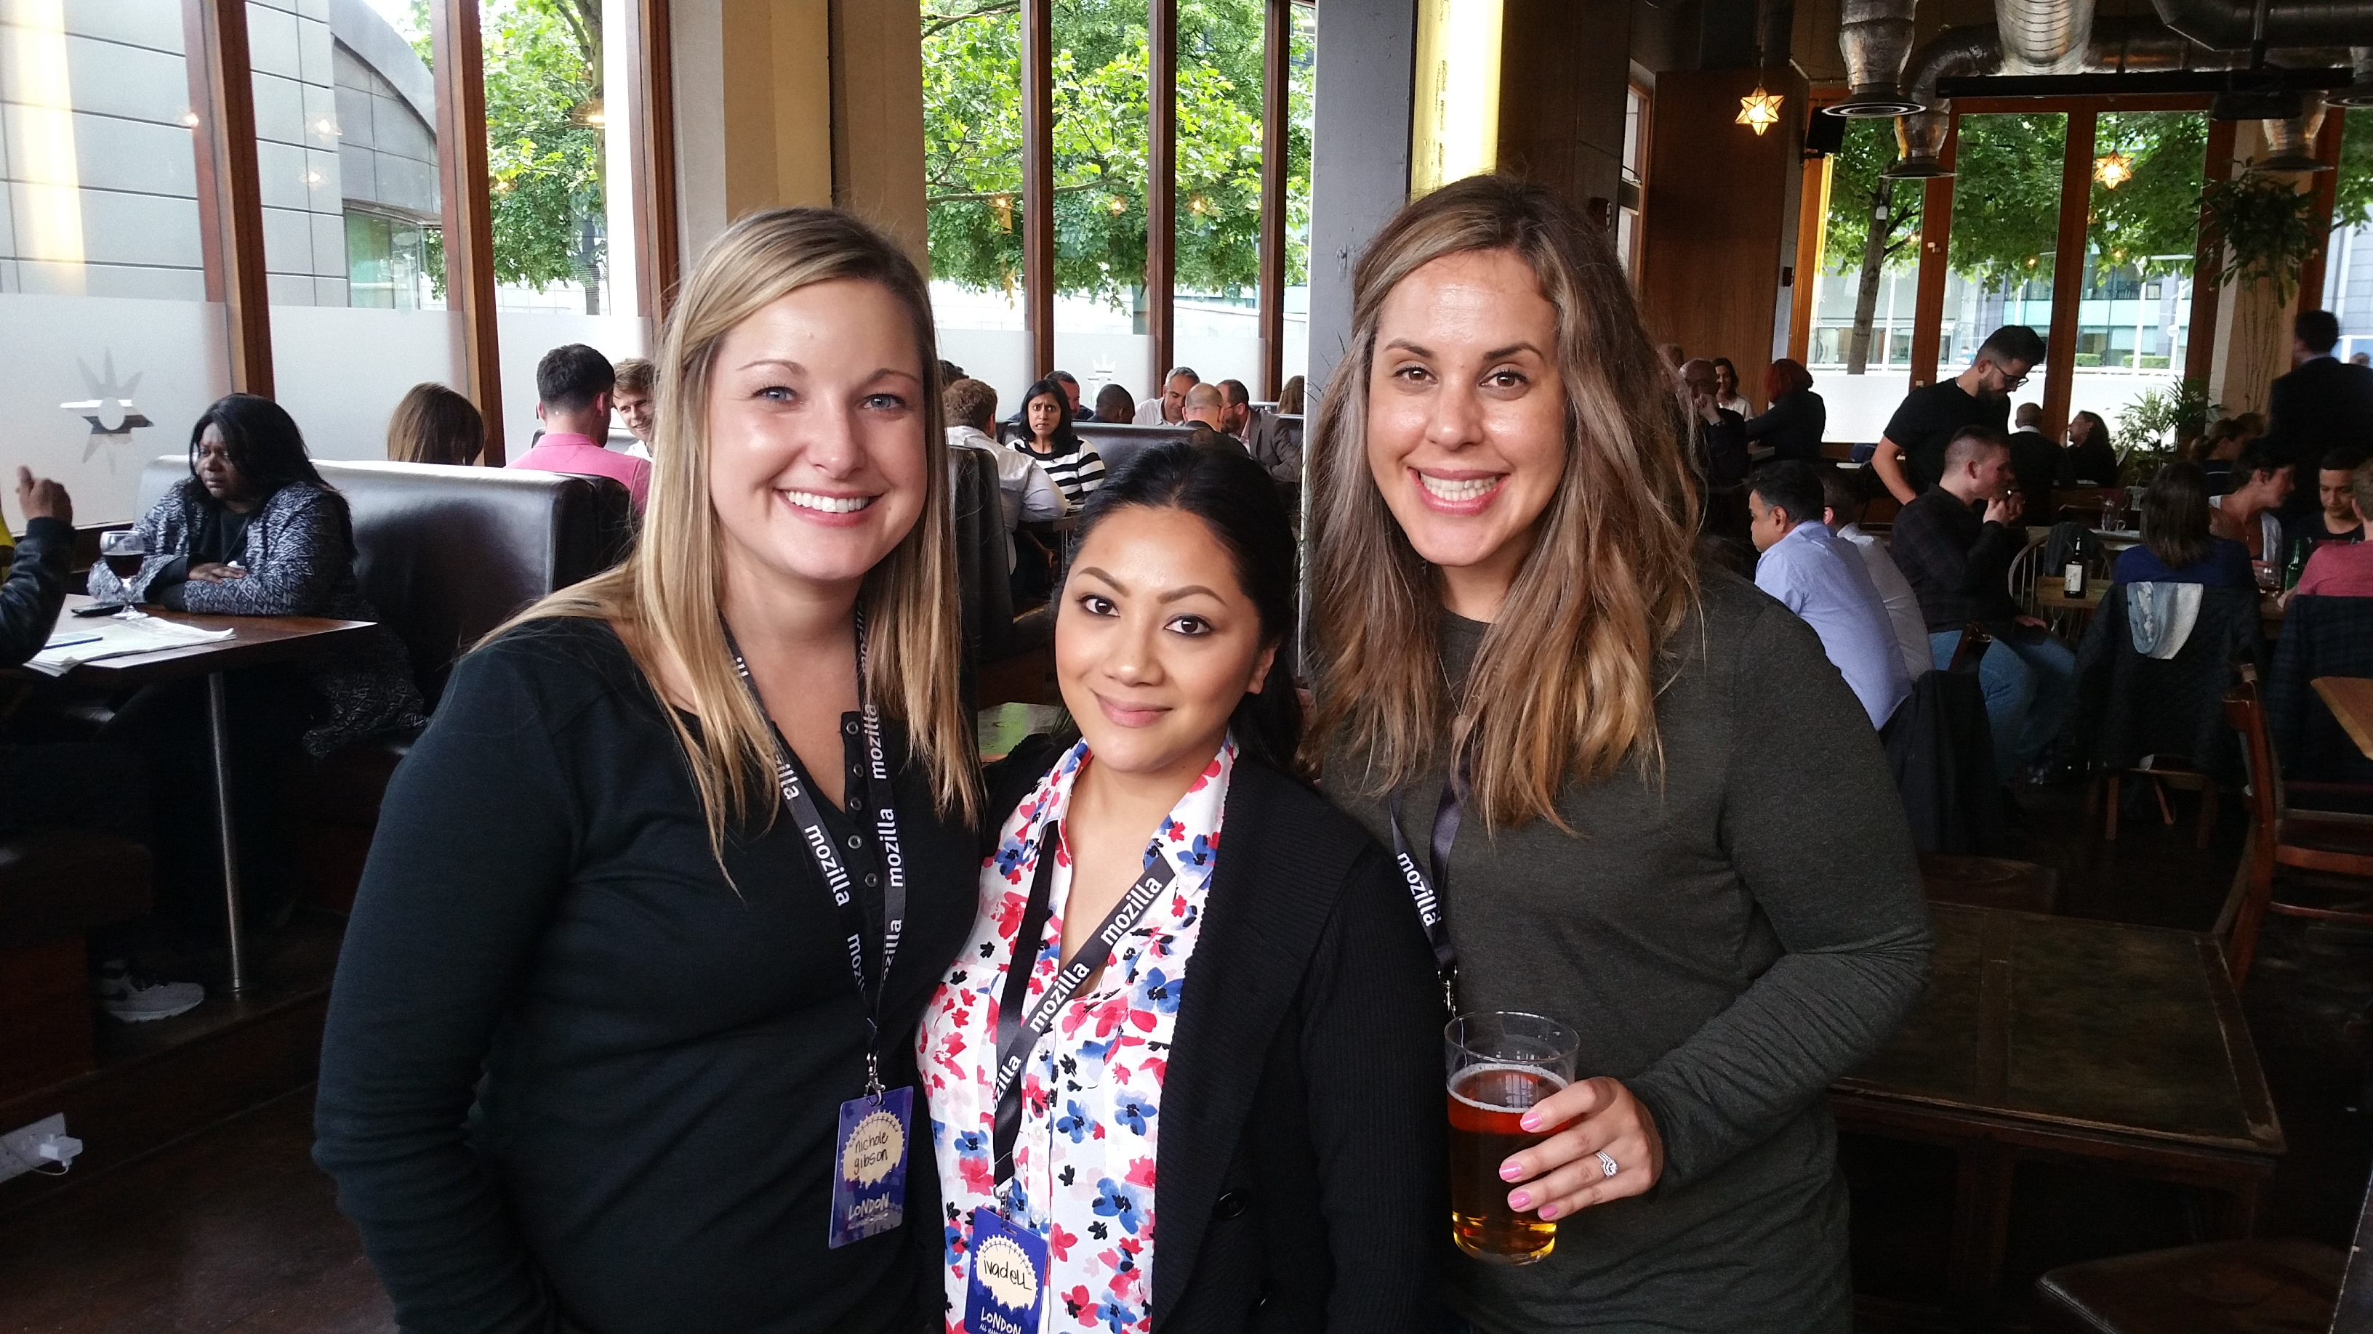
Thanks to..
University Recruiting Team (INT- Ivadell, Nichole and Tara)

Slide 34
Thanks to..
The FxA Team:
Chris Karlof (ckarlof) – For finding time despite his tight schedule
John Morrison (jrgm) – For require(module)
Ryan Feeley (rfeeley) – For all the UX guidance, and the numerous revisions and reviews.
Daniel Coates (dcoates) – For merging my PR’s for `able`.
Phil Booth (pb) – For flexboxes
Sean `Monstar` – For the security history stuff
Jon Buck – For being a gladiator

Slide 35
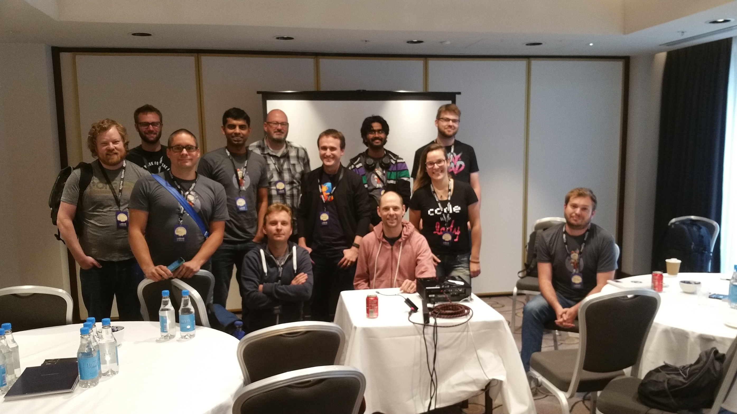
The FxA Team

Slide 36
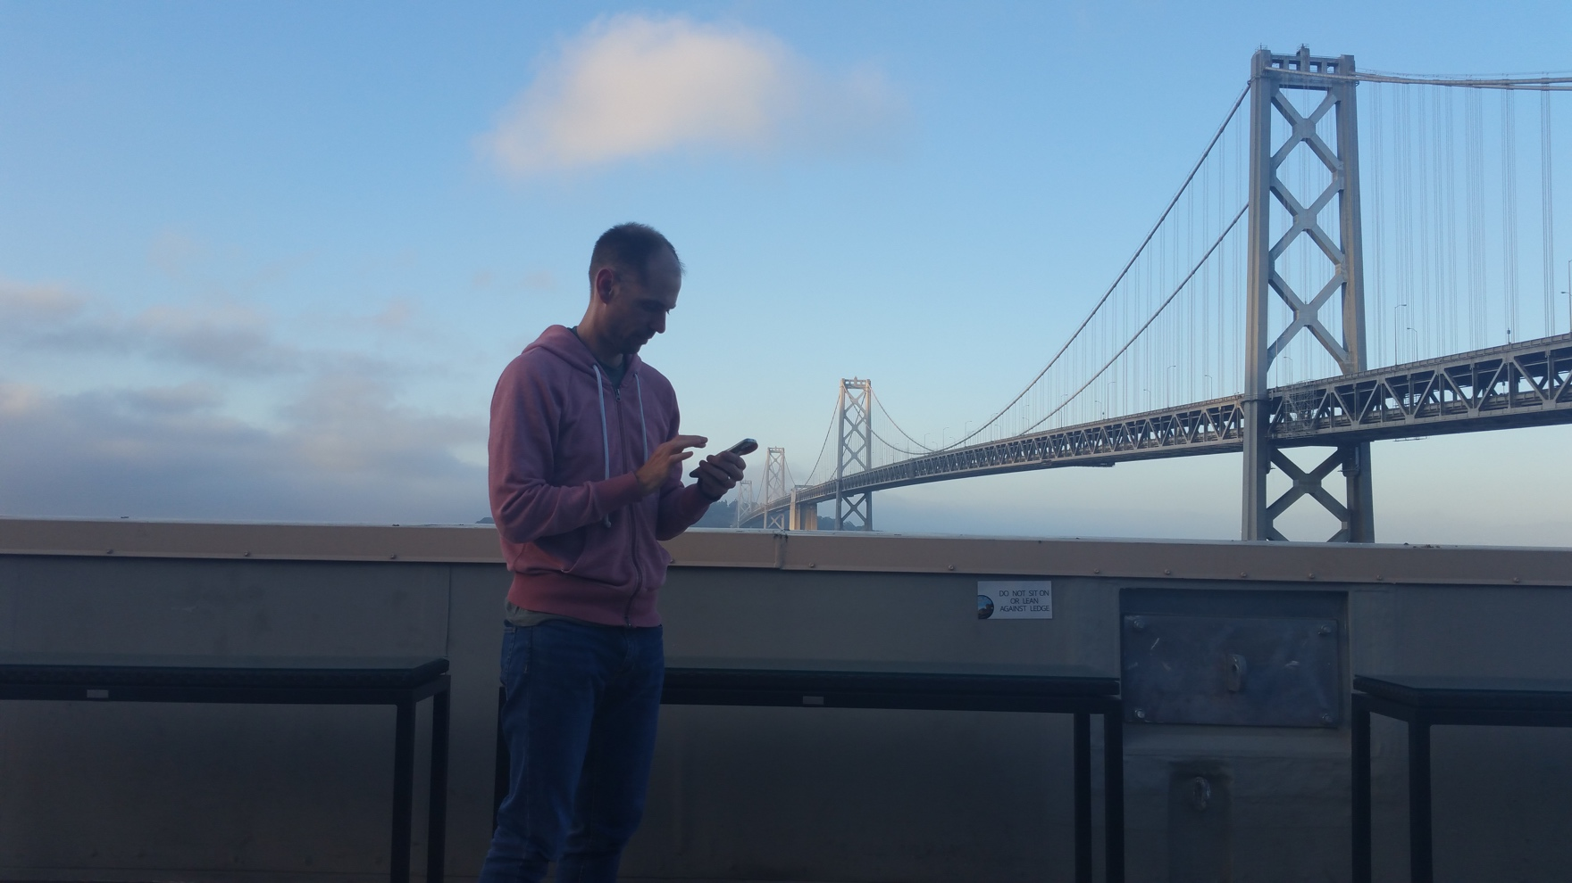
Special Thanks to..
Shane Tomlinson (stomlinson) – My Mentor and Guide
For being patient with me, and helping me separate the “must-haves” and the “nice-to-haves”, and almost everything else this summer ☺
Thanks Shane!!!

Slide 37
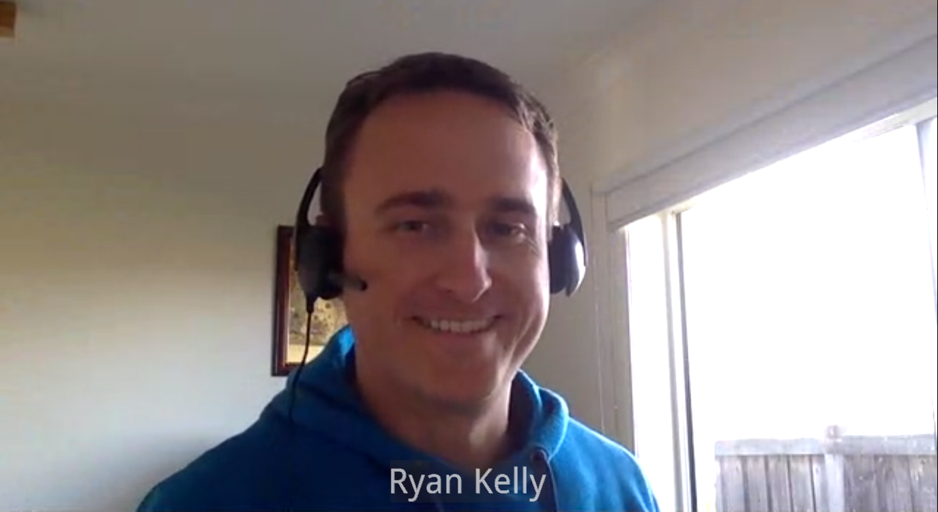
Special Thanks to..
Ryan Kelly (rfk) – My Manager
For guiding me and steering my projects in the right direction by having regular meetings, and organizing meetings for me with other members of the team. Thanks Ryan!!!

Slide 38
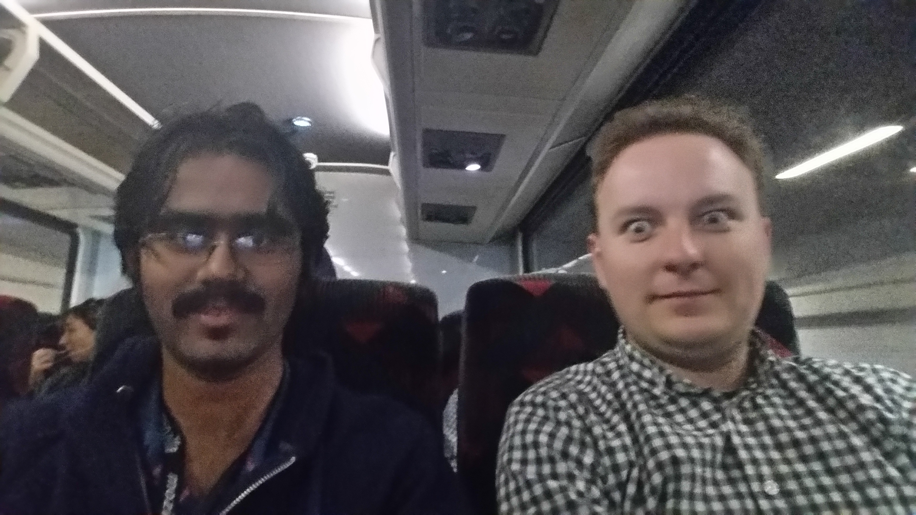
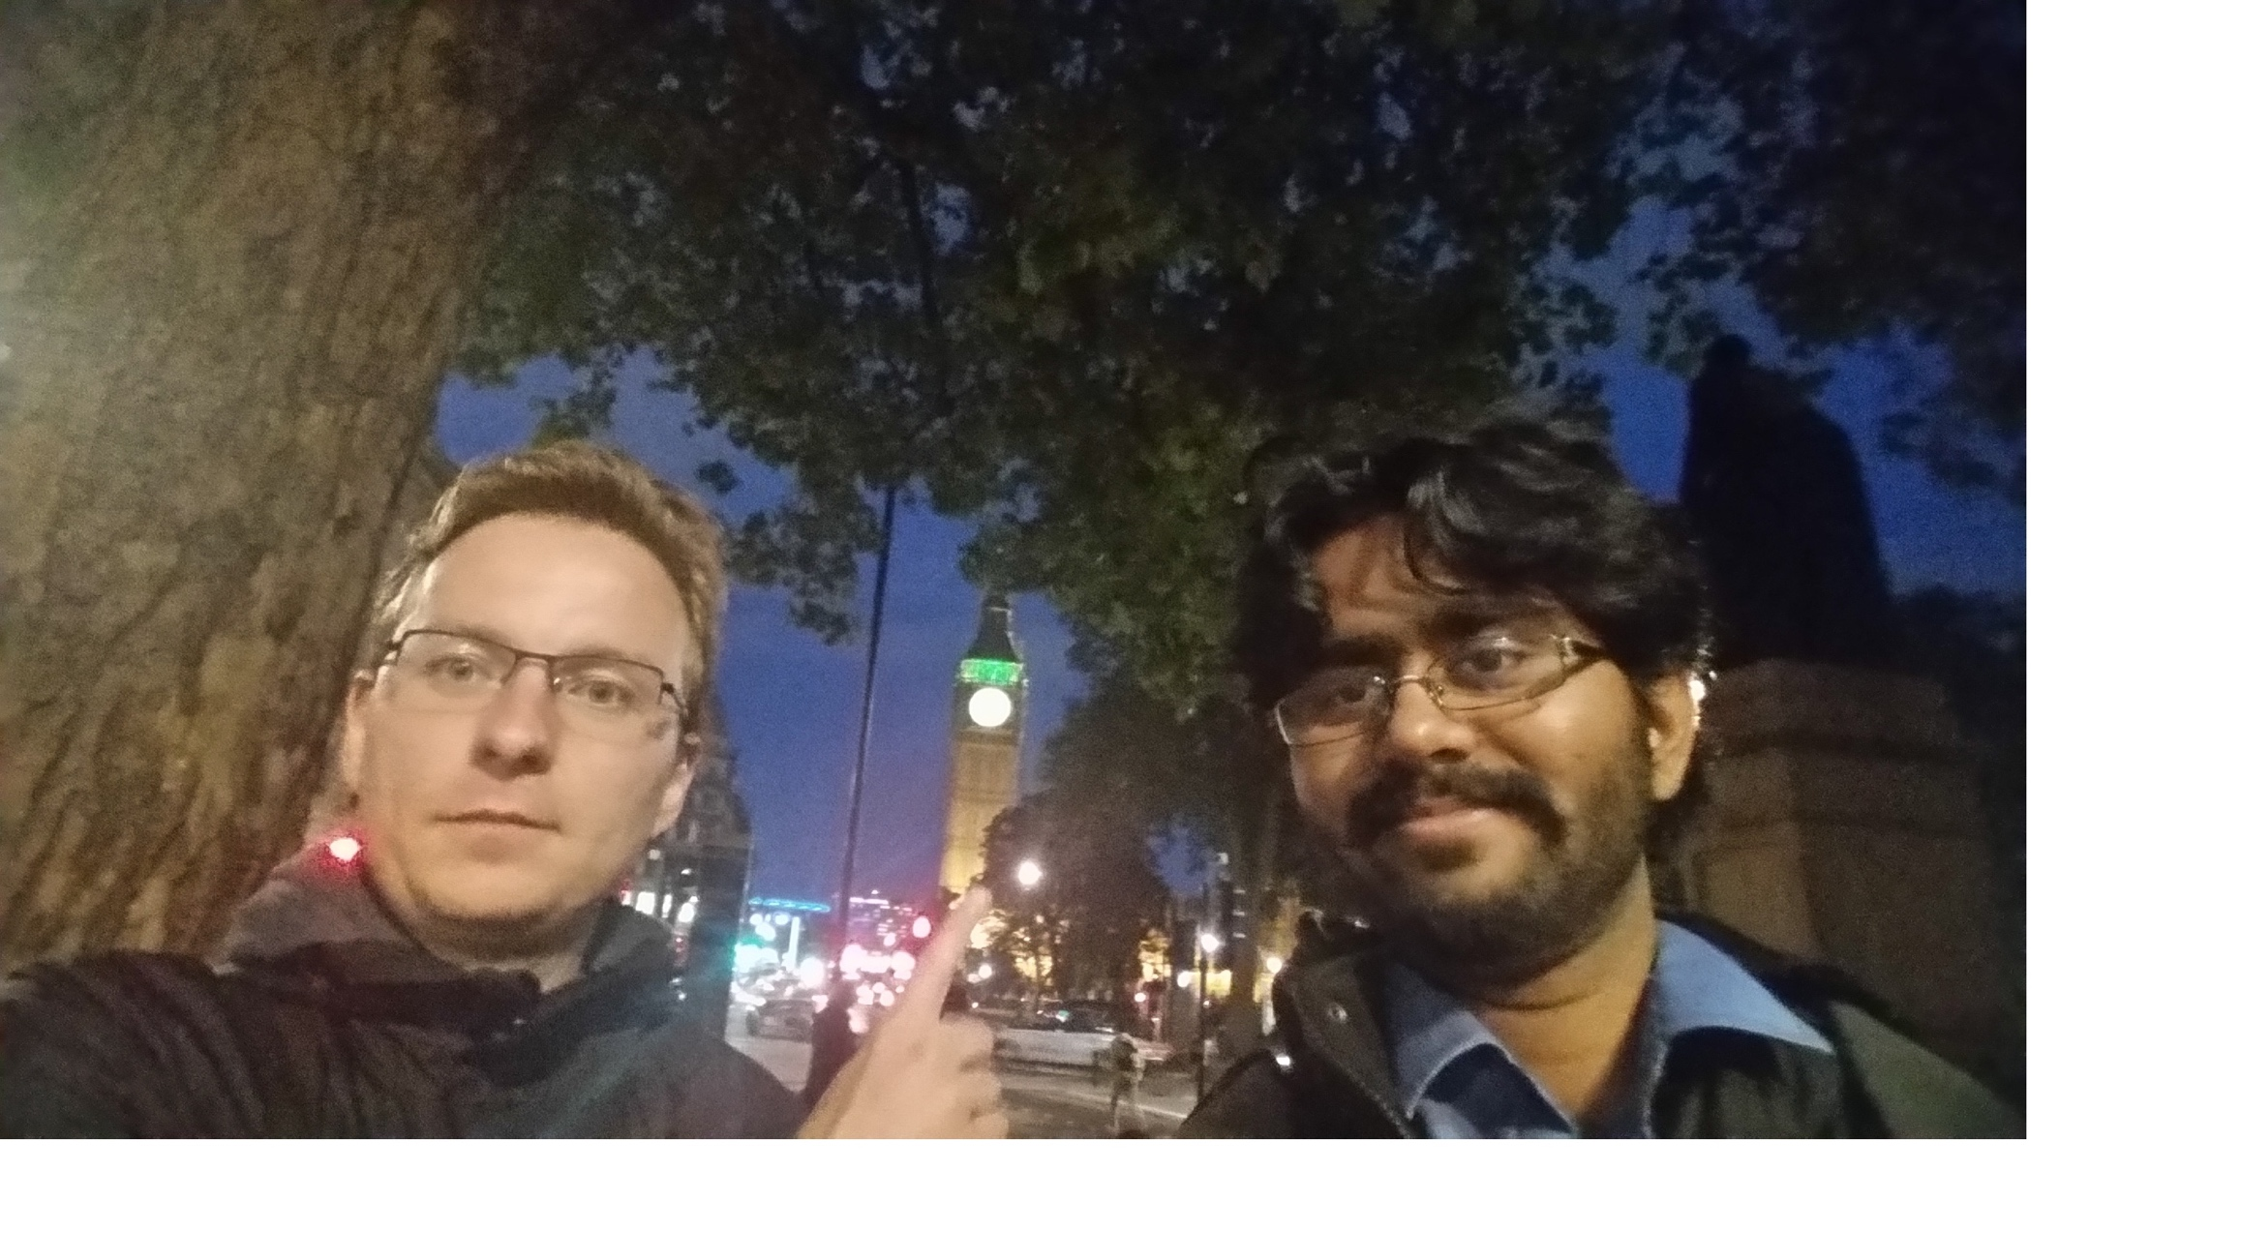
And..
Vlad Filippov (vladikoff) – He is a robot, don’t tell him though.
For the 100+ reviews he gave tirelessly, and for showing me the Big Ben. Thank you so much Vlad! ☺

Slide 39
And..
Vijay Budhram (vbudhram)
For all the help with designing fxa-geodb. Thank you so much Vijay! ☺

Slide 40
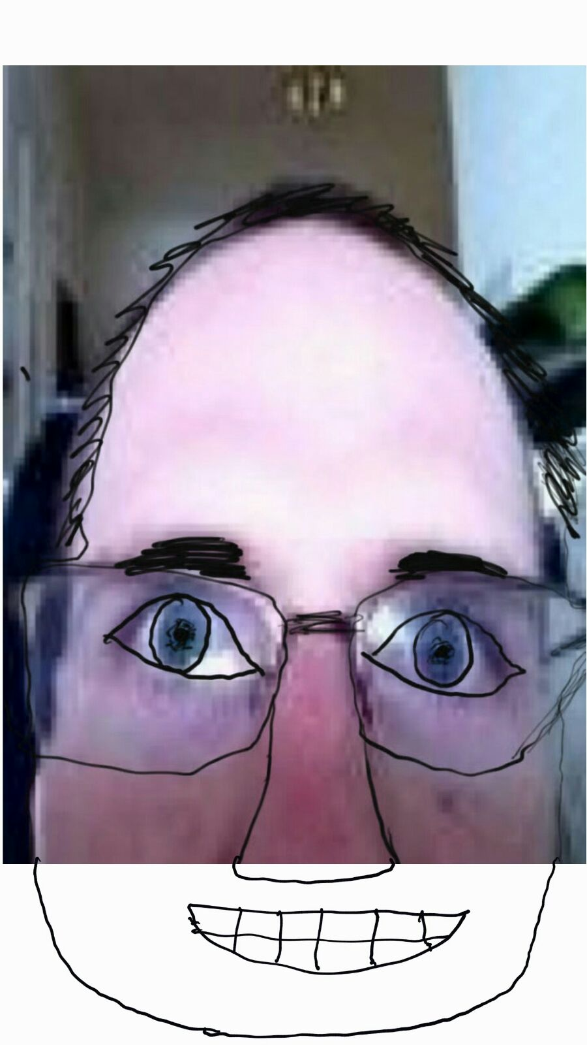
And..
Peter Dehaan (pdehaan) – a.k.a Sensei.
Thank you so much Peter, for teaching me to always look at the lighter side of software☺

Slide 41
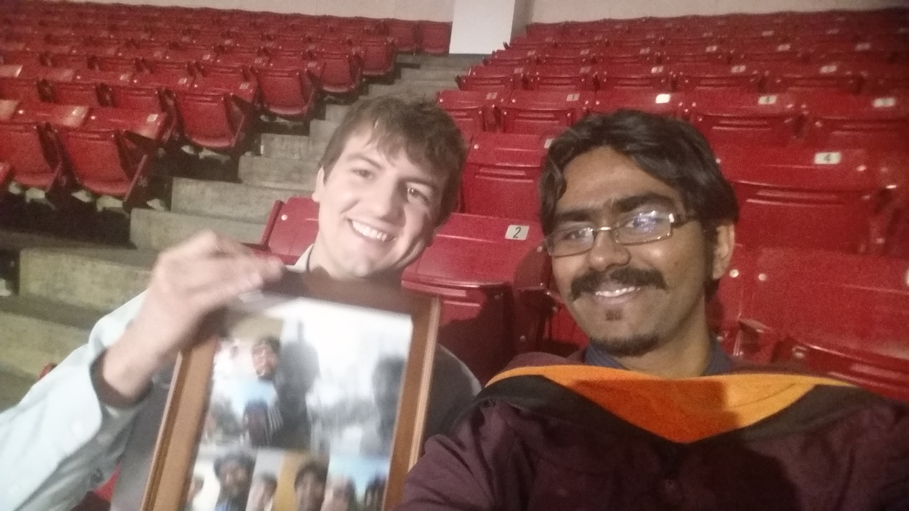
And Finallllly..
Dr. Adam Doupe (adamd) – The man who taught me everything I know about security.

Slide 42
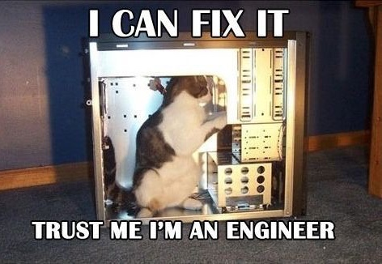
Slide 42: "Answer to The Ultimate Question of Life, the Universe, and Everything".
Questions???
The font used on the slides in general is Corbel(Body). The headings are Corbel(Headings). The slides are a default preset from MS Powerpoint.
The font used on this page is Comic Sans MS(aka most hated font of all times), just to irritate anyone who has an aversion to it. Trust me, I am a web developer.

